Slide 1
Welcome to the
York LGBT
Forum’s AGM
2022
www.yorklgbtforum.org.uk

Slide 2
TIMETABLE
Socialising - 19:00
Open and house keeping - 19:10
Guest Speaker: Henry Holland - 19:15
History of the Forum - 19:45
Break - 20:00
Minutes Approval of AGM 2021 - 20:10
Co-chair report - 20:15
Financial report - 20:30
Elections of Trustees (Emily and Ian) - 20:40
AOB - 20:50
Close - 21:00
www.yorklgbtforum.org.uk

Slide 3
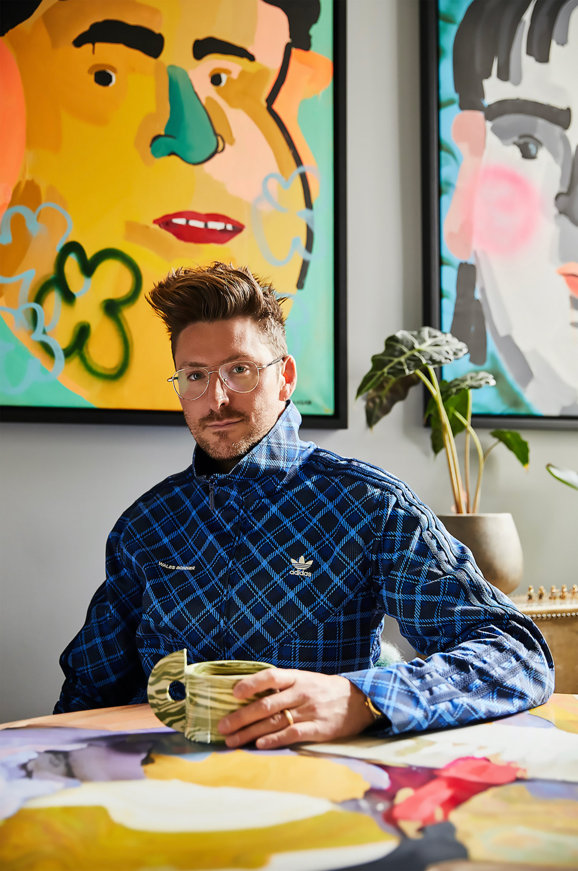
GUEST
SPEAKER:
HENRY
HOLLAND
www.yorklgbtforum.org.uk

Slide 4
York LGBT Forum
A History

Slide 5
2006
When it all begins…
York LGBT Forum is established as a community group.
The focus is to inform the council and other key agencies about the issues faced by LGBT people.
The first event is a Picnic in the Park at Rowntree Park – including a dog show!

Slide 6
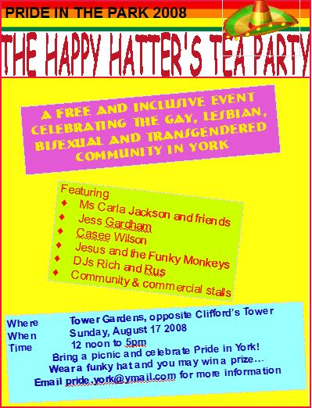
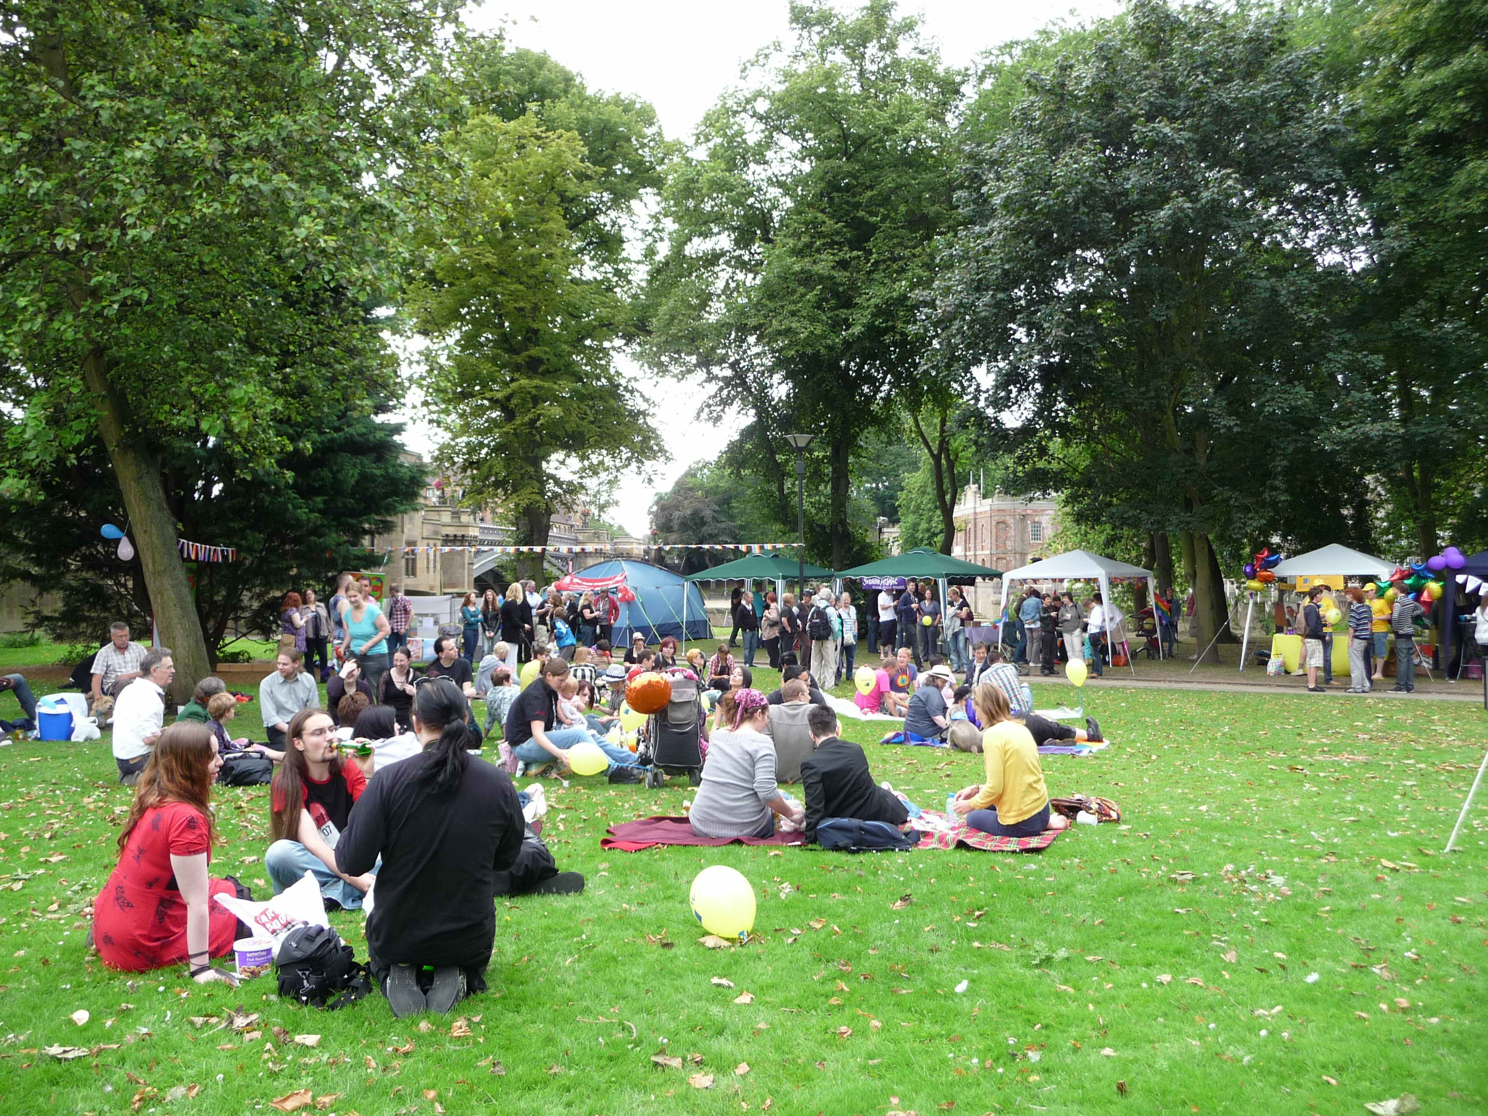
2007 - 2010
York Pride takes place at Rowntree Park Ampitheatre (2007)
Happy Hatter’s Tea Party in Tower Gardens for Pride (2008; 2009).
York Pride at Rowntree Park Ampitheatre (2010).
York LGBT Forum builds networks and relationships with multiple organisations in York.
York LGBT Forum begins providing social groups and workshops in local community.

Slide 7
2011 Remembering David Kato

Slide 8
2012
York Pride officially forms its own charity.
York Pride moves location with a parade from the Minster to its new site on the Knavesmire.
York LGBT Forum continues with its grassroots work raising awareness of LGBT issues throughout the year.

Slide 9
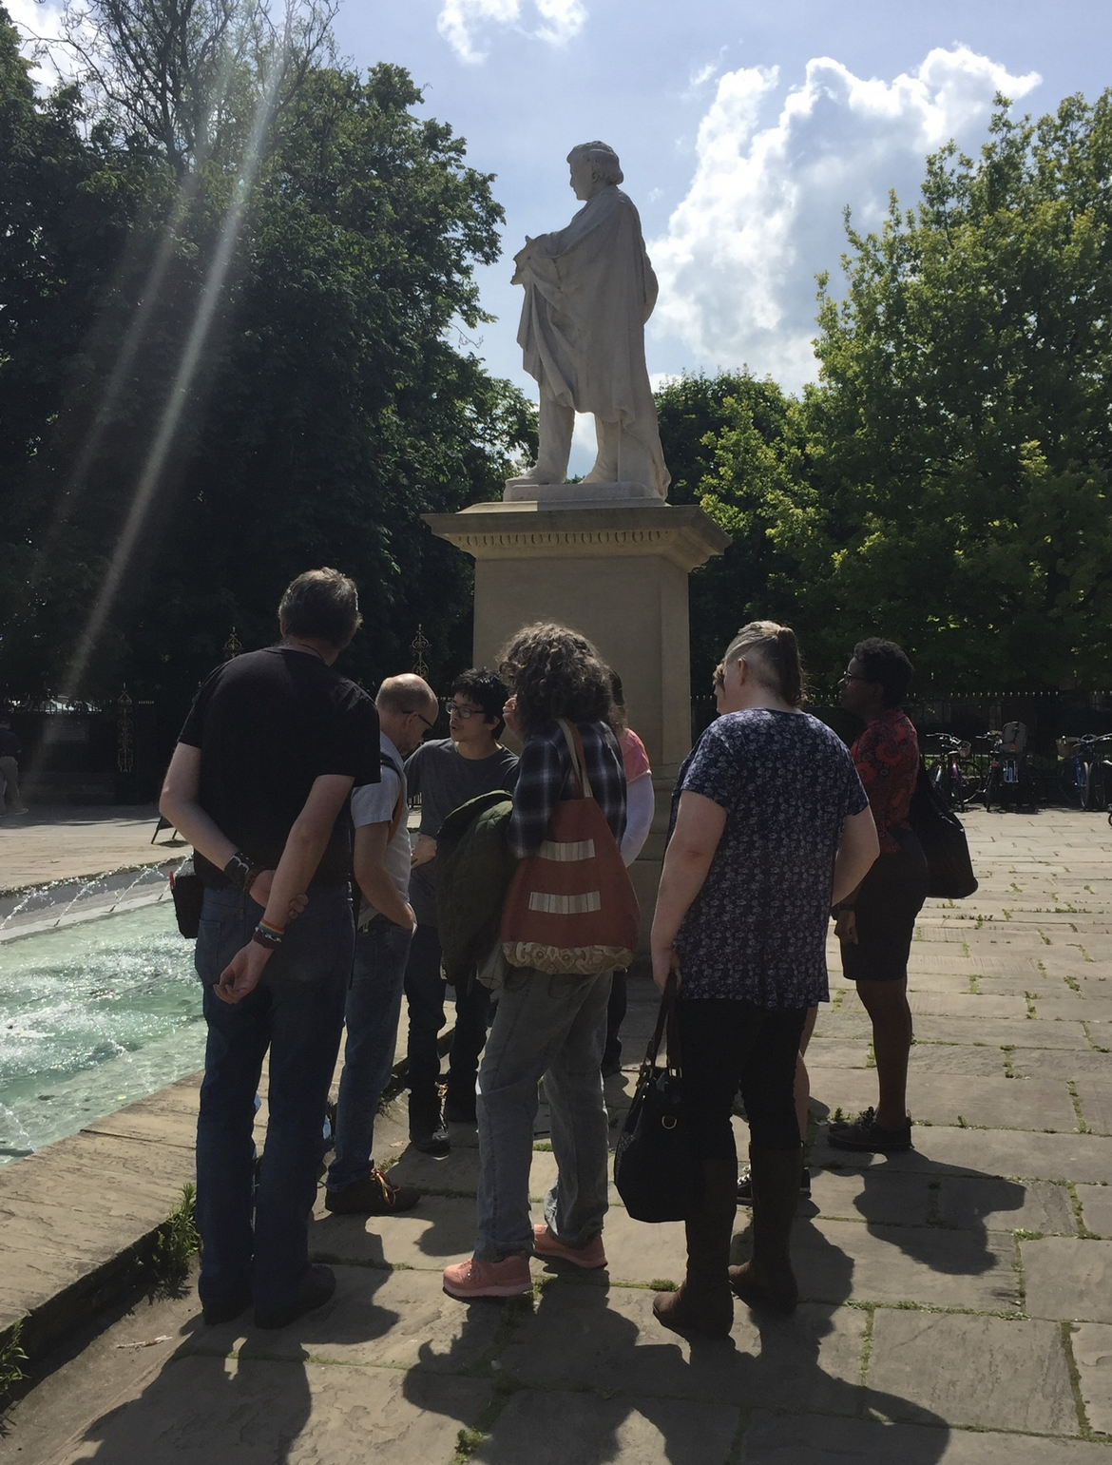
2013
York LGBT Forum leaflet summarises how we worked together towards inclusiveness, diversity and fairness.
LGBT History Walk around York organised as part of LGBT History Month.
The LGBT History Walk is resurrected by Jake Furby in 2019 (see photos)!

Slide 10
2014
Real People Theatre perform “Anne Lister’s Ladies” for York International Women’s Week with Sue & Ann as butch lesbians visiting the Gateways in London in the 1950s.
‘Books for Schools Project’ begins with It Gets Better: Coming Out, Overcoming Bullying, and Creating a Life Worth Living by Dan Savage and Terry Miller. This project continues today.
The Equal Marriage Act marks a massive step forward in the normalisation of same-sex relationships.

Slide 11
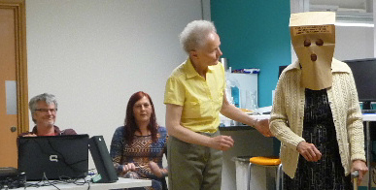
2015
At the SGM of March 2015 Lisa Kelly and Kevin Sell were elected co-chairs with Sue Lister as Acting Secretary.
Jake Furby develops comprehensive “York LGBT Forum Health and Wellbeing Action Plan 2013-2017”.
Free to Be Me in Care begins its pilot presentations in care homes with Kevin Sell, Lisa Kelly, Ann Murray and Sue Lister.
Lisa Kelly begins workshops specifically for Transgender individuals. These workshops would go on to become one of York LGBT Forum’s core projects.

Slide 12
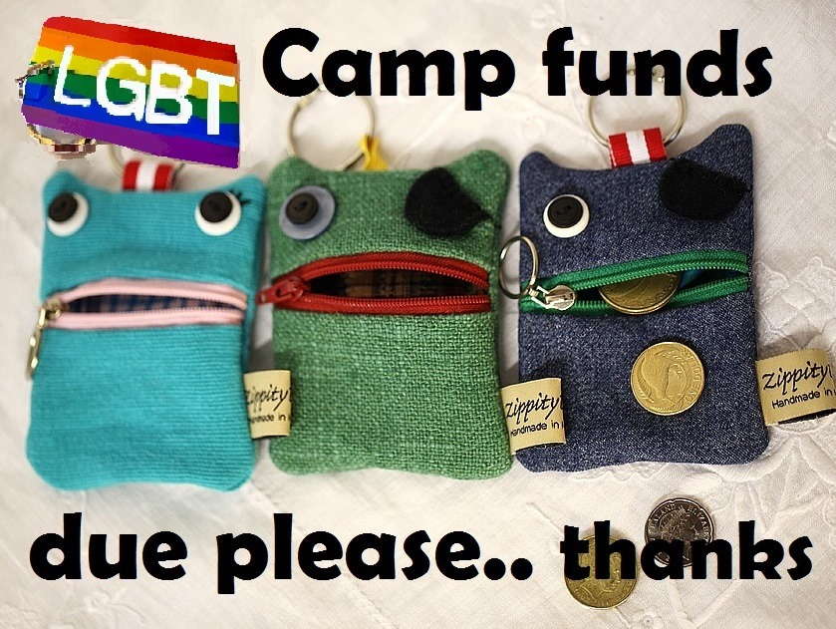
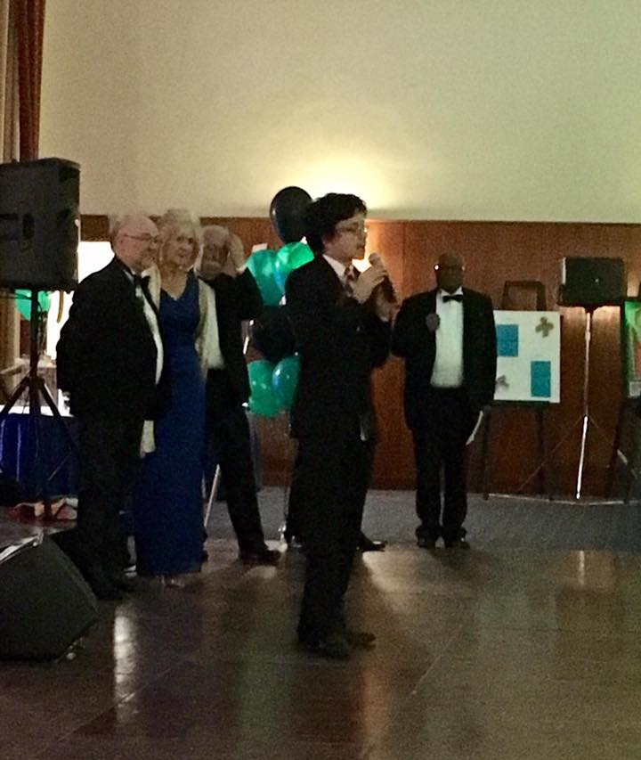
2016
Lord Mayor Dave Taylor chooses York LGBT Forum as a Lord Mayor’s Charity.
York LGBT Forum runs the OutWord Bound LGBT Poetry Competition for young people in conjunction with York LGBT History Month.
Free to Be Me in the Workplace begins.
Forum member San Yates hosts the first LGBT summer camp, attended by many of the York LGBT Forum members.
Sue Lister and Ann Murray begin monthly meetings for those ageing without children – AWOC, working closely with the York LGBT Forum.

Slide 13
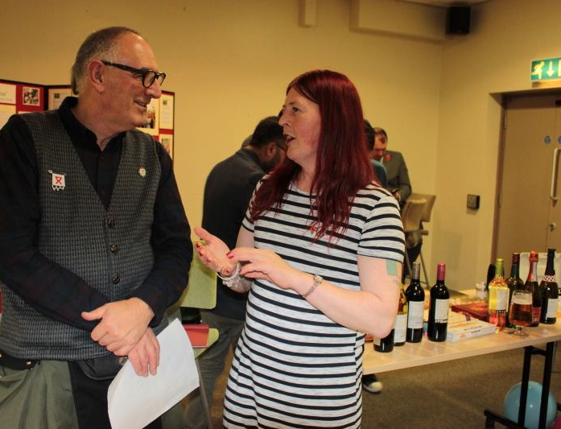
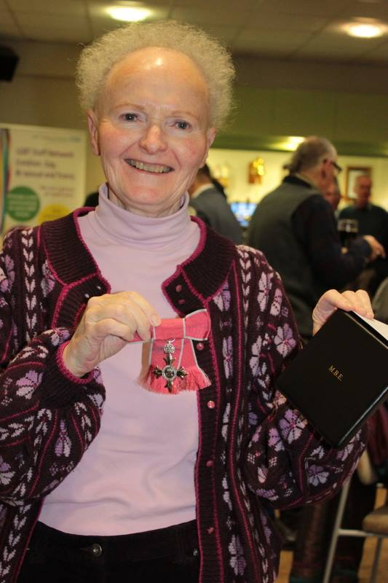
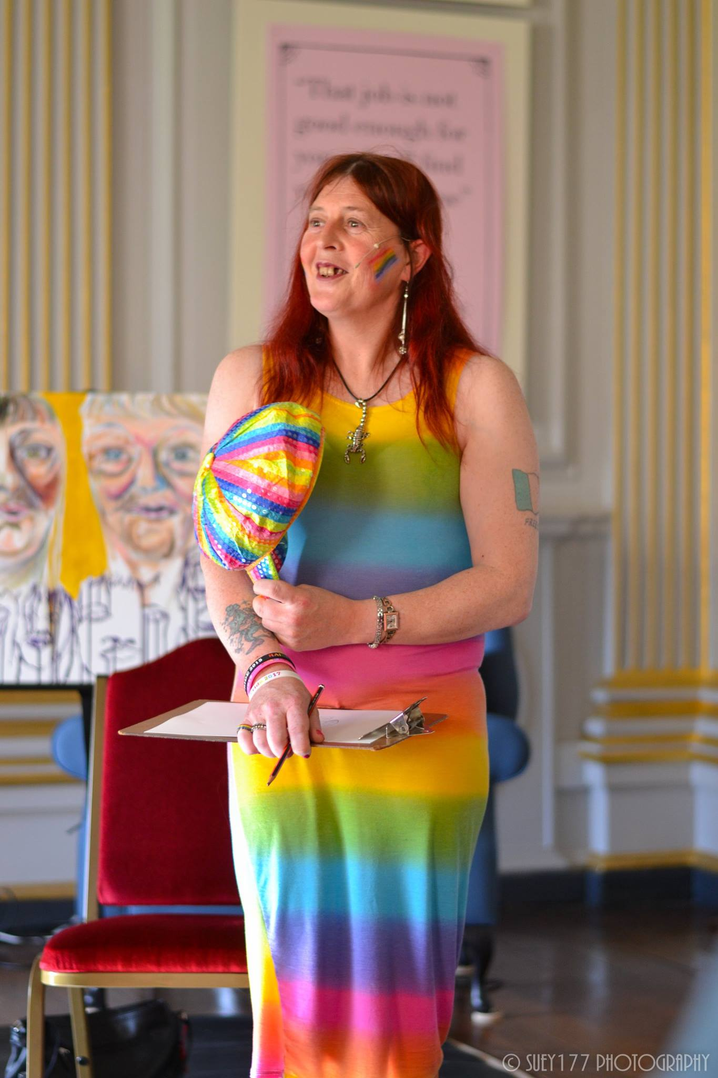
2017
Sue Lister MBE!
Time To Be Out move from Forum umbrella to form independent charity.
Emily Roach organises socials for Bisexual people and allies in York.
Lisa Kelly is painted by visual artist Tanya Raabe-Webber at Beningbrough Hall. The painting is sponsored by The National Trust.
Ian Holdsworth is elected Co-Chair replacing Kevin Sell.
Jonathan Blake is the Guest Speaker at the AGM.

Slide 14
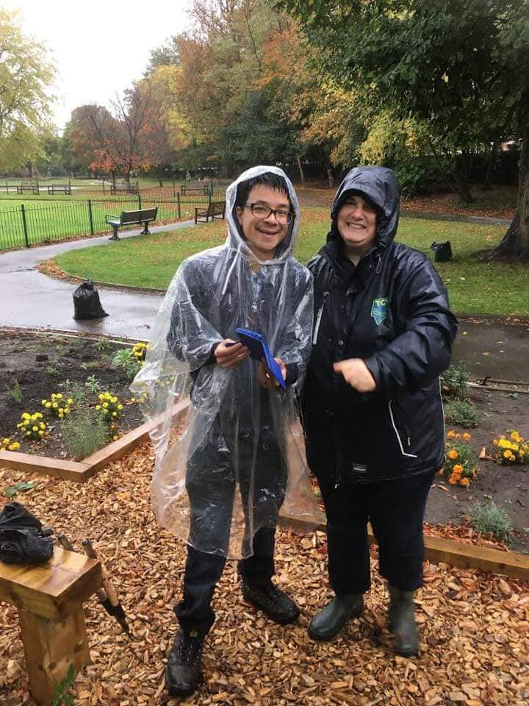
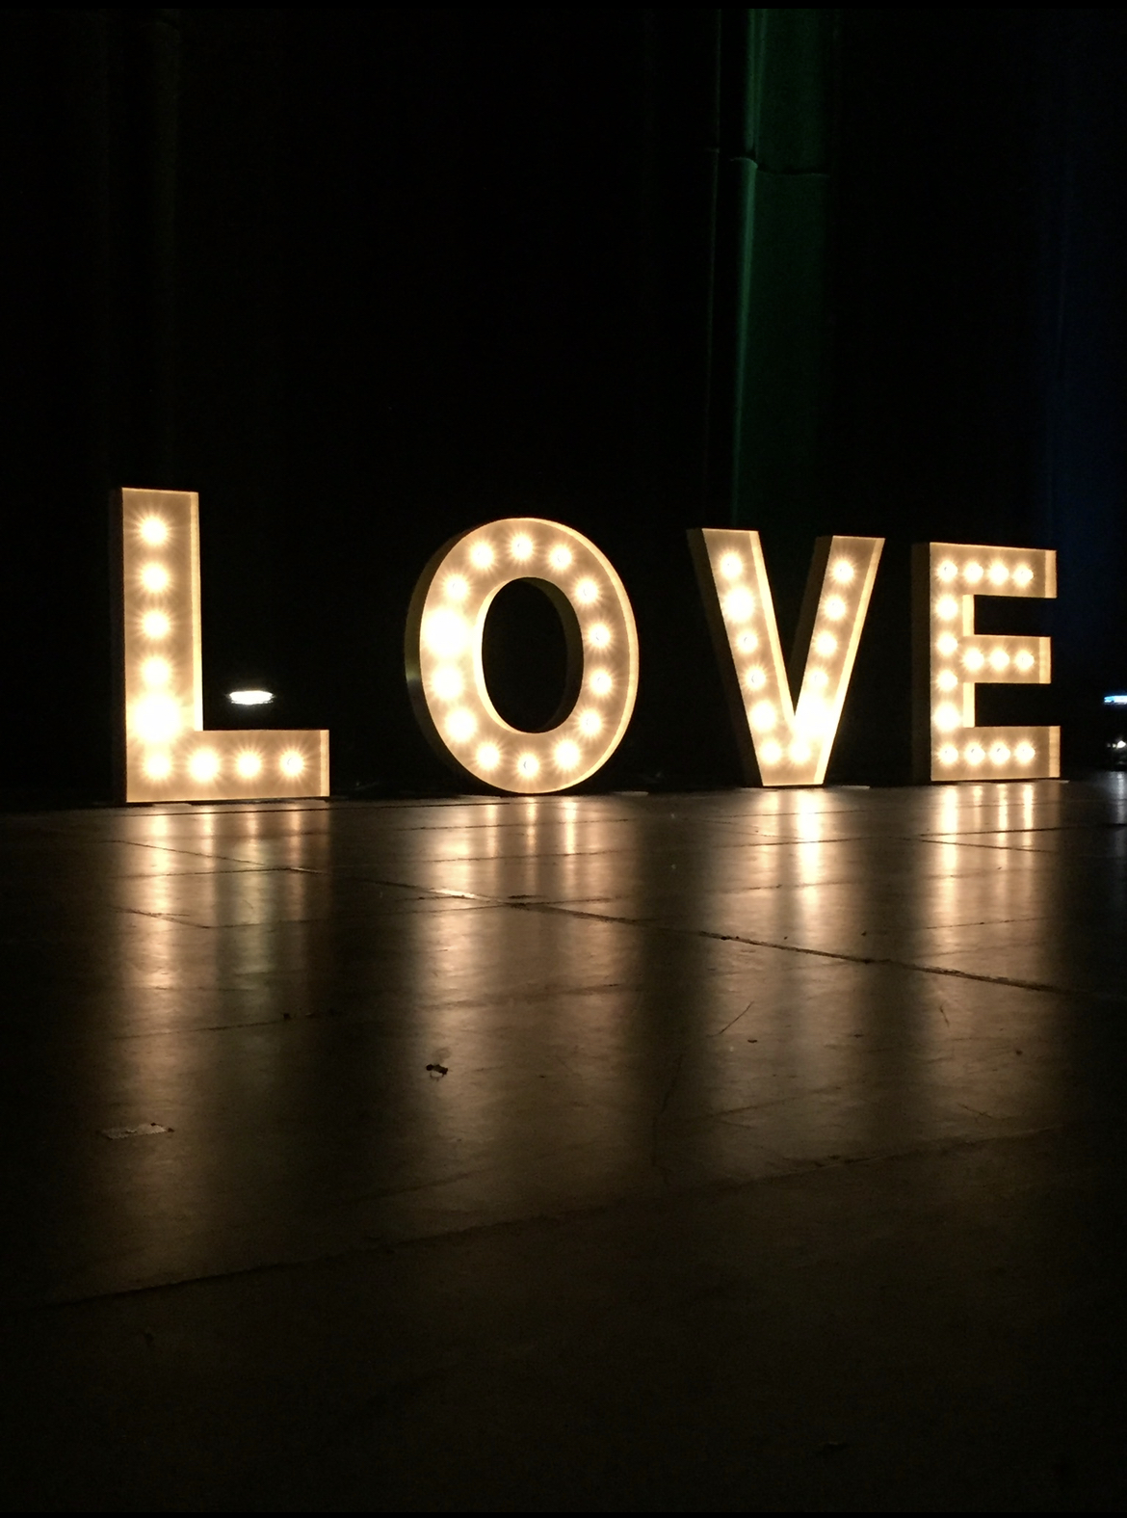
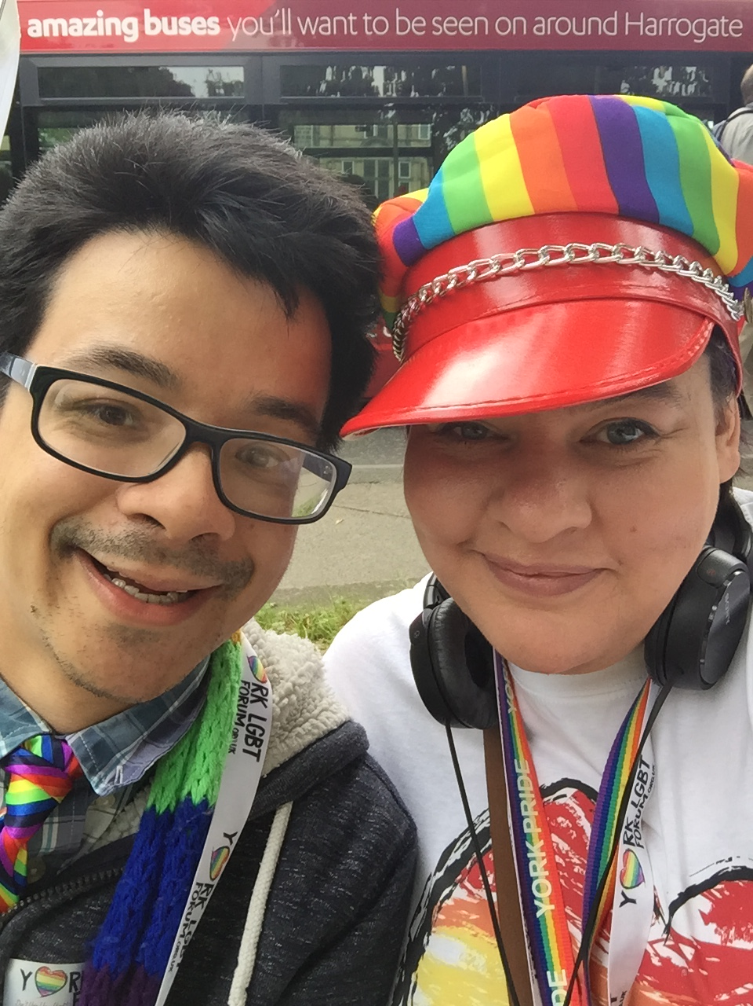
2018
‘Bring on Tomorrow’ a play written and produced by our Events Coordinator Steven Clark plays at York Barbican.
Real People Theatre creates ‘No Kidding?’ and tours around Yorkshire.
Paper Bag People play at the Birmingham NEC in April as part of the Dementia Care & Nursing Home Expo.
The York Human Rights Garden is officially opened, a collaborative project between York LGBT Forum and York Conservation Volunteers.
York LGBT Forum have stalls at many different Pride events around the North of England, including Harrogate Pride.

Slide 15
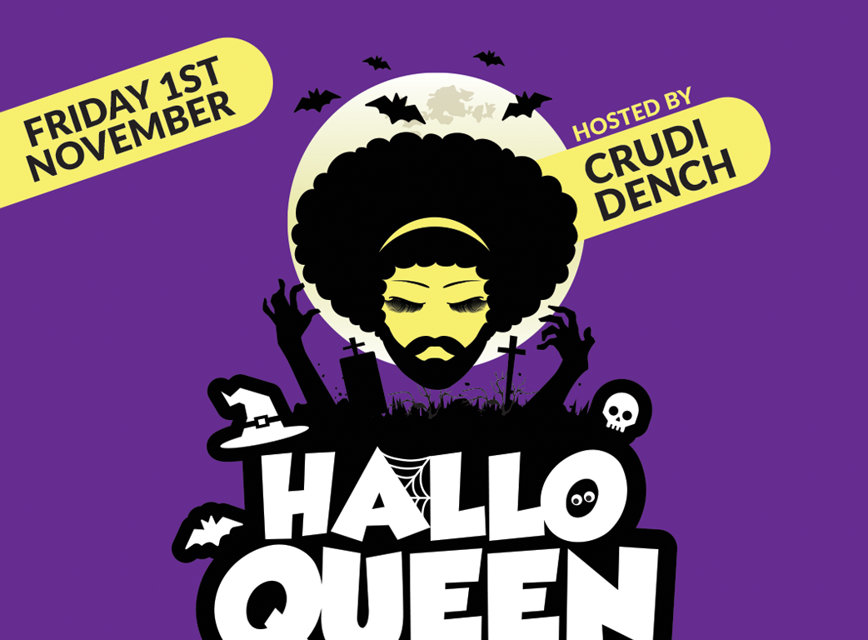
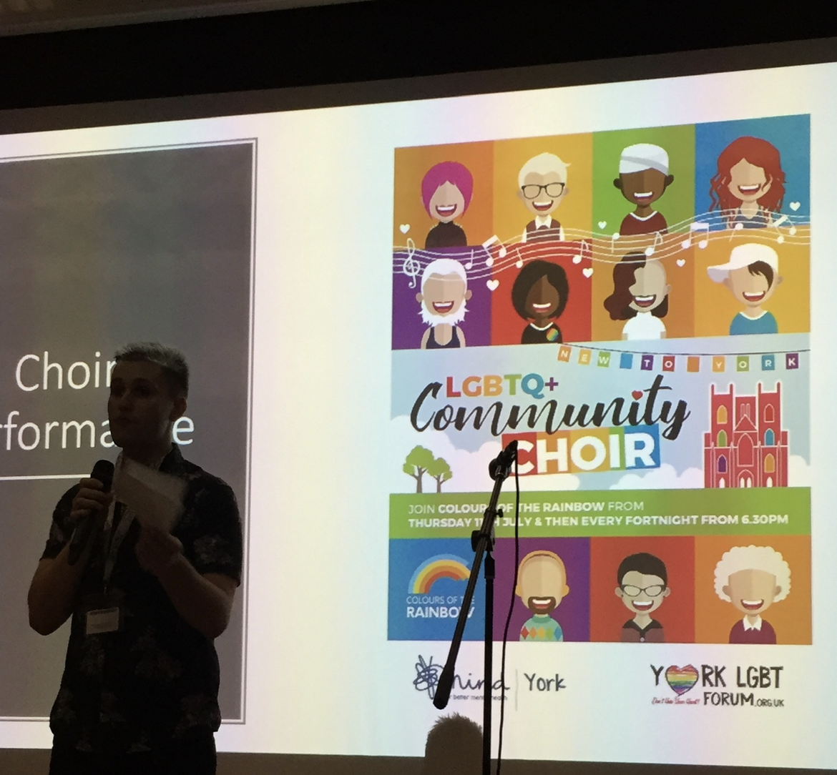
2019
York’s first ‘rainbow plaque’ to Anne Lister is unveiled in February at Holy Trinity Church.
Colours of the Rainbow Choir led by Wayne Dawson release a charity single, ‘Through the Storm’. The video features Drag Queen Divina de Campo.
A successful year of grant funding enables multiple important projects to run.
Events Coordinator James Dickinson organizes the highly successful HalloQueen and Queer Comes Christmas events.
Helena Whitbread, who transcribed the code in Anne Lister’s diaries, is our AGM guest speaker.

Slide 16
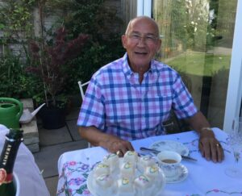
2020
COVID-19 brings significant changes.
Mental health issues soar.
York LGBT Forum events such as the York and Northallerton Coffee Socials all move online.
CJ Allison begins a highly successful Multifaith Event.
Neil Cutler becomes the diversity lead on the board of Dementia Forward.
Queer Arts is launched by Wayne Dawson.

Slide 17
2021
Jodi Burn and other volunteers produce the excellent Trans Day of Visibility Online Gig featuring poetry and music.
Hannah Exton works with the York LGBT Forum to bring the Coffee Socials back face-to-face.
Opening the Closet Door on Dementia, a collaboration between Paper Bag People and Neil Cutler, is booked for multiple workshops in York, Ripon and surrounding areas.
Neil Cutler and Martina Stuart joined the Free to be Me in Care team.

Slide 18
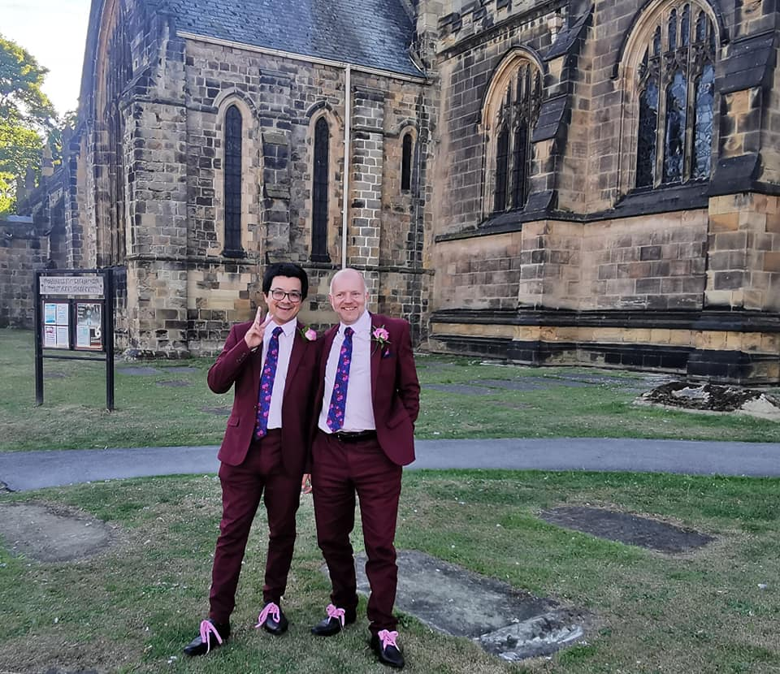
2022
Queer Arts leaves the umbrella of the York LGBT Forum to become a separate Community Interest Company.
Free To Be Me in Care resumes face-to-face.
Neil Cutler’s LGBT talk becomes a regular part of staff induction at Lister House.
York LGBT Forum runs several successful Pizza Socials at Spark.
York LGBT Forum collaborates with York Art Gallery on the ‘Queering the Gallery’ project.
Our own Jake Furby and CJ Allison celebrate their civil partnership.

Slide 19
Let’s
TAKE A
BREAK
www.yorklgbtforum.org.uk

Slide 20
MINUTES &
MATTERS
ARISING
FROM THE
2021 AGM
www.yorklgbtforum.org.uk

Slide 21
PRESENTATION
OF ANNUAL
REPORT &
CO-CHAIRS'
REPORT
www.yorklgbtforum.org.uk

Slide 22
PRESENTATION
OF ACCOUNTS
www.yorklgbtforum.org.uk

Slide 23
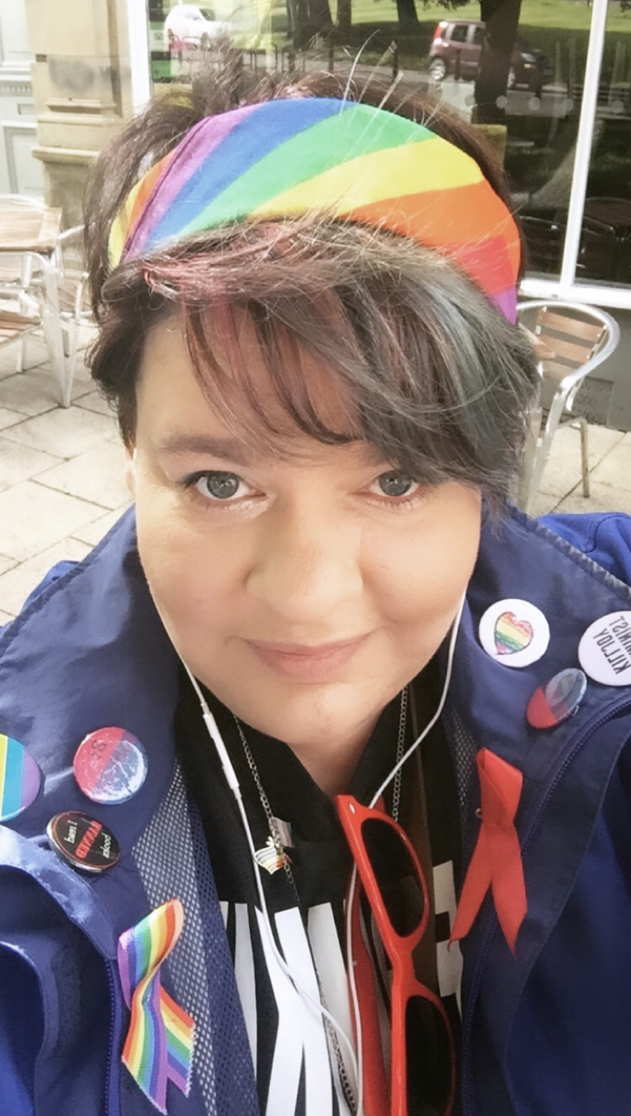
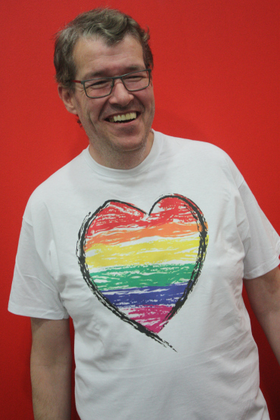
TRUSTEE
ELECTIONS
www.yorklgbtforum.org.uk

Slide 24
CAN YOU HELP?
WE’RE LOOKING FOR
TRUSTEES
www.yorklgbtforum.org.uk

Slide 25
ANY
OTHER
BUSINESS
www.yorklgbtforum.org.uk

Slide 26
RAFFLE
www.yorklgbtforum.org.uk

